Slide 1

Pengantar Basis Data
Dan ERD
Disusun oleh:
Boby Siswanto, ST, MT – boby.siswanto@gmail.com
Program Studi D3 Teknik Informatika -Fakultas Ilmu Terapan

Slide 2

REFERENSI
Abraham Silberscahatz, Henry F. Korth. Database System Concepts. McGraw-Hill
Raghu Ramakrisnan, Gherke. Database Management System. McGraw-Hill

Slide 3
Definisi
Field
Basic element of data (name, date, etc.)
Record
Collection of related fields that we treat as a unit (employee record)
May be of a fixed or variable size
File
Collection of similar records
Treated as an entity by applications
Usually referenced by a name
Access controls usually at file level
Data
Known facts that can be recorded and have an implicit meaning.

Slide 4
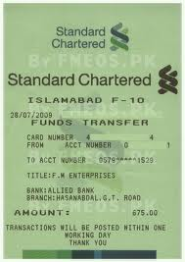
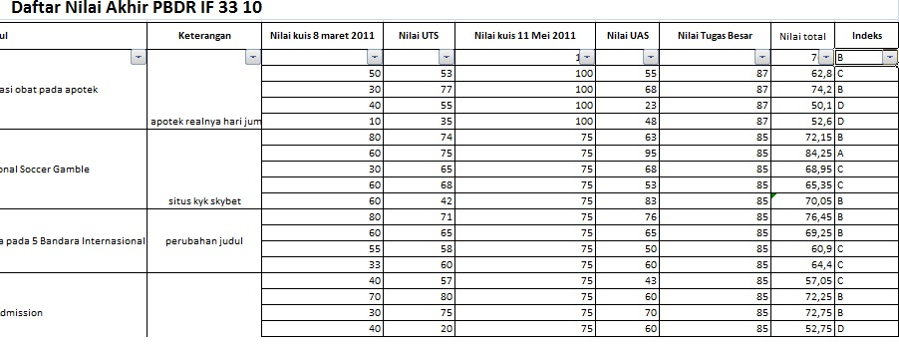
DATA VS INFORMASI
Notes:
Data: Kumpulan Fakta di dunia nyata
Informasi : sesuatu / data / fakta yang bermakna bagi seseorang.
Informasi punya beberapa kemungkinan:
Berasal dari data dan tidak perlu pengolahan misal : skor bola bagi pecinta bola
Berasal dari data dan mengalami pengolahan misal: data pembelian celana jeans selama sebulan di griya diolah terlebih dahulu sebelum menjadi informasi pola pembelian jeans dan informasi ini berguna bagi seorang manajer pemasaran griya.
4

Slide 5
Ilustrasi Database
Real
World
Facts about world and behaviour of world
represented in
contents and operations of a database
facts about the world in a database
more facts
some more rather long facts about the world in the databse
facts about the world in a database
more facts
some more rather long facts about the world in the databse
facts about the world in a database
more facts
some more rather long facts about the world in the databse
facts about the world in a database
more facts
some more rather long facts about the world in the databse
facts about the world in a database
more facts
some more rather long facts about the world in the databse
Database
facts about the world in a database
more facts
some more rather long facts about the world in the databse
Users
facts about the world in a database
more facts
facts about the world in a database
more facts
facts about the world in a database
more facts
facts about the world in a database
facts about the world in a database
more facts
facts about the world in a database
facts about the world in a database
facts about the world in a database
facts about the world in a database
facts about the world in a database
facts about the world in a database
facts about the world in a database
facts about the world in a database
facts about the world in a database

Slide 6
DBMS
Database Management System (DBMS)
A software package/ system to facilitate the creation and maintenance of a computerized database.
Database System
The DBMS software together with the data itself. Sometimes, the applications are also included.
Database Management System (DBMS) provides….
… efficient, reliable, convenient, and safe
multi-user storage of and access to massive amounts of persistent data.

Slide 7
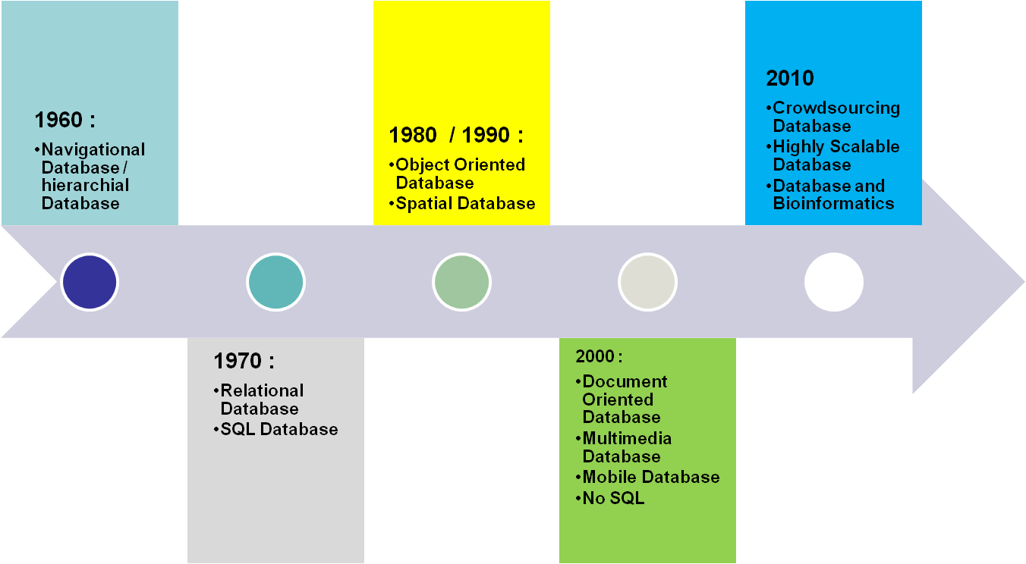
History of Database
Notes:
Tahun yang ada di timeline ini merupakan tahun lahirnya/mulainya penelitian tentang jenis database tertentu.
Sampai sekarang (2012), semua jenis database kecuali Navigational Database dan hierarchial database masih terus diteliti.
7

Slide 8
A simplified database architecture
DBA
Users/
Programmers
Database
System
Database
Description
Application Programs/
Interactive Queries
DBMS
DDL
Compiler
Data
Access
Query Processor
Catalog
Database

Slide 9
Data Models
A collection of tools for describing
data
data relationships
data semantics
data constraints
Entity-Relationship model
Relational model

Slide 10
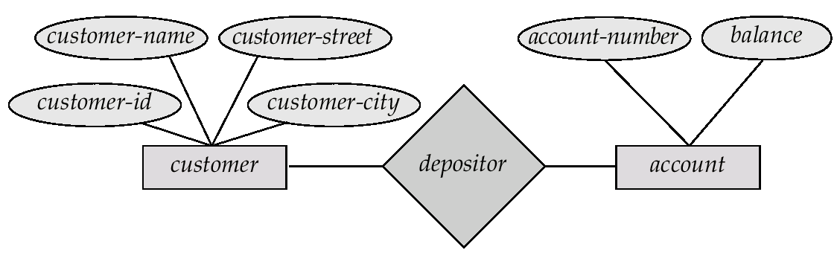
Contoh ER Model
Notes:
E-R model of real world
Entities (objects)
E.g. customers, accounts, bank branch
Relationships between entities
E.g. Account A-101 is held by customer Johnson
Relationship set depositor associates customers with accounts
Widely used for database design
Database design in E-R model usually converted to design in the relational model (coming up next) which is used for storage and processing
10

Slide 11
Contoh DDL dan DML
CREATE TABLE ACCOUNT(
account_number VARCHAR2(24) PRIMARY KEY,
balance NUMBER);
INSERT INTO ACCOUNT(account_number, balance)
VALUES (‘x1234567890’, 50000);
SELECT * FROM ACCOUNT;
Notes:
E-R model of real world
Entities (objects)
E.g. customers, accounts, bank branch
Relationships between entities
E.g. Account A-101 is held by customer Johnson
Relationship set depositor associates customers with accounts
Widely used for database design
Database design in E-R model usually converted to design in the relational model (coming up next) which is used for storage and processing
11

Slide 12
Contoh Relational Model
Attributes
Customer-id
customer-
name
customer-
street
customer-
city
account-
number
192-83-7465
019-28-3746
192-83-7465
321-12-3123
019-28-3746
Johnson
Smith
Johnson
Jones
Smith
Alma
North
Alma
Main
North
Palo Alto
Rye
Palo Alto
Harrison
Rye
A-101
A-215
A-201
A-217
A-201

Slide 13
Databases Everywhere!!!
DBMS contains information about a particular enterprise
Collection of interrelated data
Set of programs to access the data
An environment that is both convenient and efficient to use
Database Applications:
Banking: all transactions
Airlines: reservations, schedules
Universities: registration, grades
Sales: customers, products, purchases
Online retailers: order tracking, customized recommendations
Manufacturing: production, inventory, orders, supply chain
Human resources: employee records, salaries, tax deductions
Databases touch all aspects of our lives
ORACLE DB 11G XE

Slide 14
Pengantar ER Diagram
(ERD)
Notasi Dasar
Constraints
Keys
Design Issues
Entity Sets
Relationship Sets

Slide 15
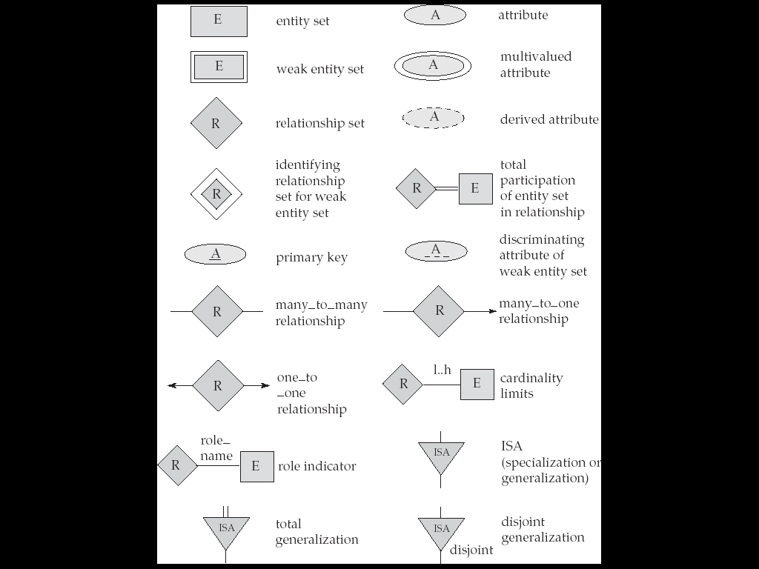
Notasi Dasar

Slide 16
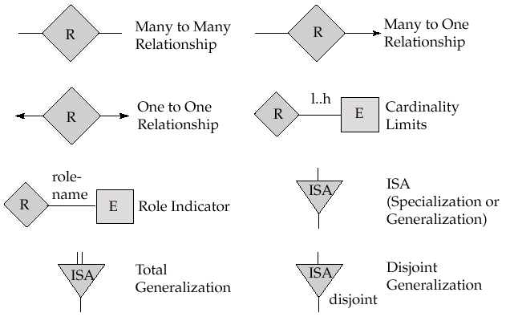
Notasi Dasar

Slide 17
Constraints
NOT NULL
Mencegah nilai null diinputkan ke tabel
UNIQUE
Mencegah diinputkannya nilai ganda pada sebuah tabel
PRIMARY KEY
Gabungan antara Unique Constraint dan Not Null Constraint
FOREIGN KEY
Memastikan nilai yang diinput ke tabel mengacu ke nilai di tabel lain
CHECK
Menentukan kondisi tertentu sewaktu melakukan input data

Slide 18
Keys
Kunci (Key) : atribut yang dapat membedakan sebuah entity di dalam entity set atau sebuah relationship didalam relationship set
Contoh :
Kunci dari mahasiswa adalah NPM
Kunci dari mata kuliah adalah kodeMK
Super Key: satu atau beberapa atribut yang secara kolektif dapat mengidentifikasi sebuah entity di dalam entity set secara unik
Candidate Key: Superkey yang minimal
Primary Key: Candidate Key yang dipilih oleh disainer database untuk mengidentifikasi sebuah entity didalam entity set
Alternate Key: Candidate key yang tidak dipilih sebagai Promary Key
Foreign Key: Key pada tabel berelasi dimana tabel relasinya memiliki Primary Key

Slide 19

Entity Set
Entity Sets
An entity is a “thing” or “object” in the real world that is distinguishable from all other objects
Objek Konkrit (Orang, Buku, Mahasiswa)
Objek Abstrak (Jadwal, Pinjaman, Tabungan, Penjualan)
An entity has a set of properties, and the values for some set of properties may uniquely identify an entity
An entity is represented by a set of attributes
Entity sets do not need to be disjoint. A person entity may be an instructor entity, a student entity, both, or neither.

Slide 20
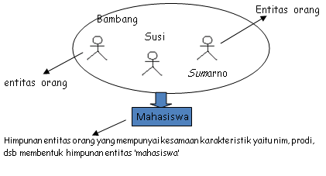
Entity Set
Entity Sets

Slide 21

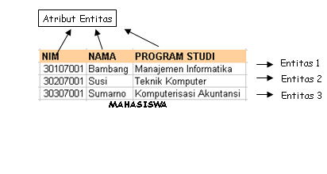
Entity Set
Entity Sets

Slide 22
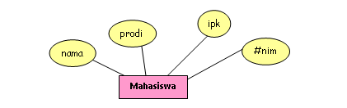
Entity Set
Entity Sets

Slide 23

Relationship
Relationship

Slide 24
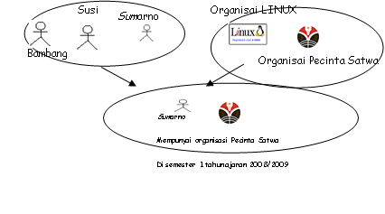
Relationship
Relationship

Slide 25
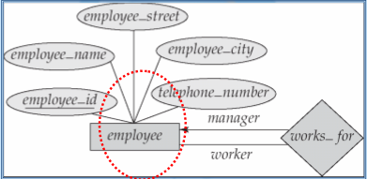
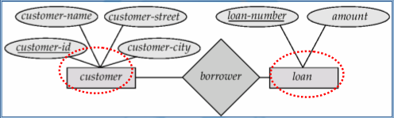
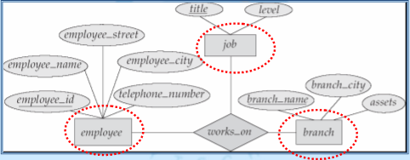
Derajat Relationship
Binary
Unary
Ternary

Slide 26
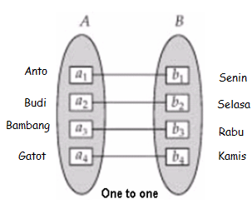
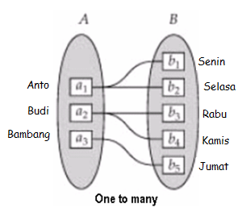
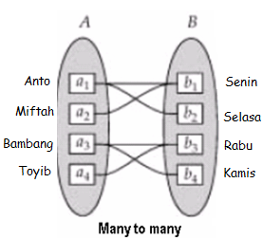
Kardinalitas Relationship

Slide 27
Attributes
For each attribute, there is a set of permitted values, called the domain, or value set, of that attribute
The domain of attribute course id might be the set of all text strings of a certain length
the domain of attribute semester might be strings from the set {Fall,Winter, Spring, Summer}
Formally, an attribute of an entity set is a function that maps from the entity set into a domain

Slide 28
Attributes
Attributes
Simple and composite attributes
Composite attributes, on the other hand, can be divided into subparts
For example, an attribute name could be structured as a composite attribute consisting of first name, middle initial, andlast name
Single-valued and multivalued attributes
Derived attribute

Slide 29
Contoh ERD Lengkap
Tgl_perwalian
NPM
Nama
KodeMK
NamaMK
Ambil_MK
Mahasiswa
Mata_Kuliah
M
N
Telepon
SKS
Alamat

Slide 30
SELESAI

